Slide 1
Towards High-performance Quantum-based LEDs: Optoelectronic Modulation of 2D Silicon Carbide for Tunable and Efficient White Light Emission
Add conference Logo and website here →
Underline presenting author’s name →
Md. Mahfuzul Haque^{1,2} and Sajid Muhaimin Choudhury^{1, *}
¹Department of Electrical and Electronic Engineering
Bangladesh University of Engineering and Technology, Dhaka 1205, Bangladesh
²Department of Electrical and Electronic Engineering
Jamalpur Science and Technology University, Jamalpur 2012, Bangladesh
Paper ID: 250103165040
Session: 4P1a - Optoelectronic Devices and Integration
Date: 2025-05-08 Time: 13:45 PM Room: 1 - CH B (A)
If there is a second university affiliation, add logo of it in middle→
Notes:
"Good afternoon everyone. My name is Dr. Sajid Muhaimin Choudhury, and I am pleased to present our work titled 'Towards High-performance Quantum-based LEDs: Optoelectronic Modulation of 2D Silicon Carbide for Tunable and Efficient White Light Emission,'

Slide 2
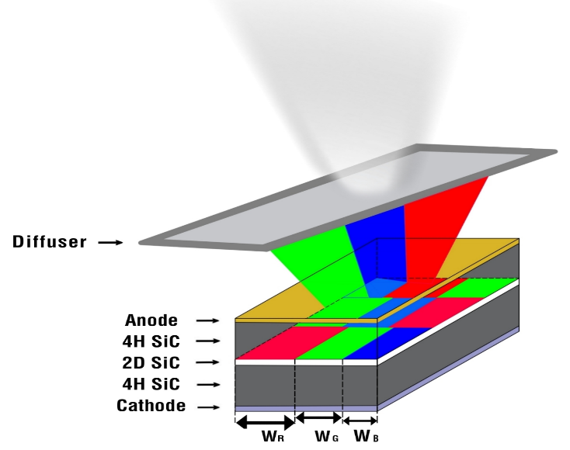
Outline of Presentation
Towards High-performance Quantum-based LEDs: Optoelectronic Modulation of 2D Silicon Carbide for Tunable and Efficient White Light Emission
Motivation
Introduction
Methodology
Design
← Add a graphical abstract or summary picture
Results
Conclusion
Acknowledgement
Notes:
Let me begin with an outline of today's talk. We'll start with the motivation and challenges in current LED technologies, move into the fundamentals of white LEDs and 2D-SiC, then dive into our proposed single quantum well design, simulation methodologies using DFT and SILVACO ATLAS, followed by key results and final design implications.

Slide 3
Motivation
Challenges in conventional LED tech: energy inefficiency, limited tunability
Importance of white LEDs in displays, illumination
2D-SiC: promising for quantum LEDs due to direct bandgap, high exciton binding energy
Each slide will have conference logo, and paper and session info →
Notes:
Despite the widespread use of LEDs, current technologies face issues like limited spectral tunability and energy inefficiency. Our motivation stems from the need to develop next-generation white LEDs with higher efficiency, stability, and color quality—where 2D-SiC stands out as a promising quantum well.

Slide 4
Motivation: Why Study 2D SiC?
← Add descriptive title in the top
Wide Bandgap
Unique Properties
High Mechanical Strength
Thermal Conductivity
High photoluminescence
Optoelectronic Advantages
Robust UV detection capabilities
A Sham et al. Science (2024)
← Always give in page reference to any data / graph
Notes:
SiC is a material with unique properties that make it ideal for LED applications. These include: A wide bandgap for efficient light generation. High mechanical strength and thermal conductivity.
Also have Excellent optoelectronic characteristics like high photoluminescence and robust UV detection.
These advantages motivated the exploration of 2D SiC for white LED development.

Slide 5

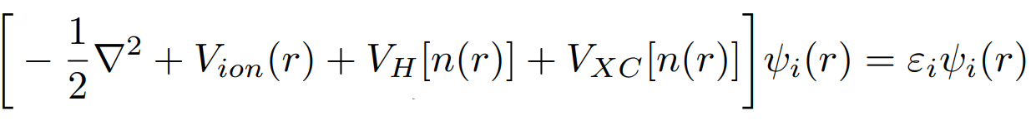

Time-independent Schrödinger equation
$\hat{H }$
Hamiltonian operator
State vector
(wave function)
Energy
Eigen value
Kohn-Sham density function equation
Kinetic Energy
External potential
Hartree potential
Exchange correlation potential
Local (spin) density Approximation
(LDA)
Generalized Gradient Approximation
(GGA)
Notes:
To understand the quantum behavior of materials like 2D Silicon Carbide, we begin with the time-independent Schrödinger equation.
However, solving this equation for many-body systems becomes extremely difficult due to the complex interactions between electrons.
To overcome this, we turn to Density Functional Theory, or DFT, which reformulates the problem in terms of electron density, n(r), rather than many-electron wavefunctions.
This leads us to the Kohn-Sham equation shown in the blue box.
Let me break this down: i) Kinetic Energy ii) External potential iii) Hartree potential iv) Exchange correlation potential
And crucially, the exchange-correlation potential, which captures the many-body effects of electron interactions. This exchange-correlation term is approximated using techniques such as: The Local Density Approximation (LDA), where the exchange-correlation energy depends locally on the electron density, Or the Generalized Gradient Approximation (GGA), which incorporates density gradients to improve accuracy.

Slide 6
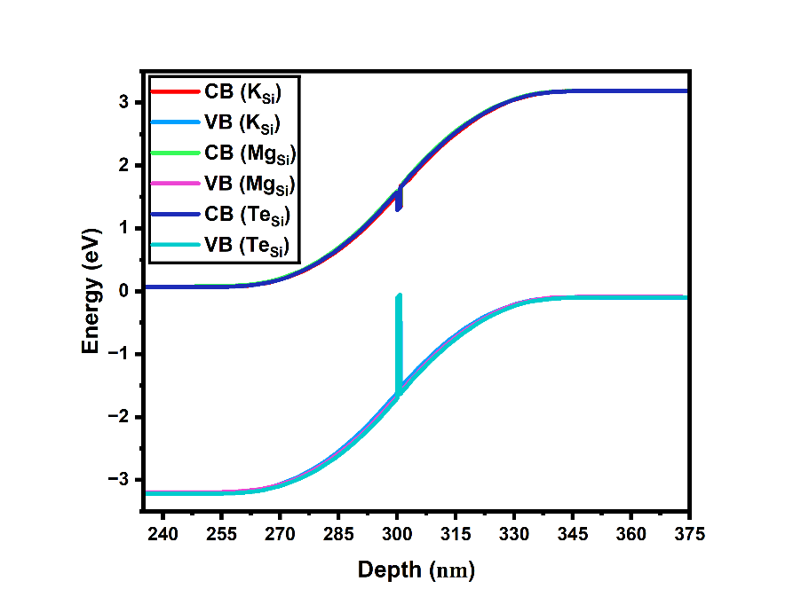
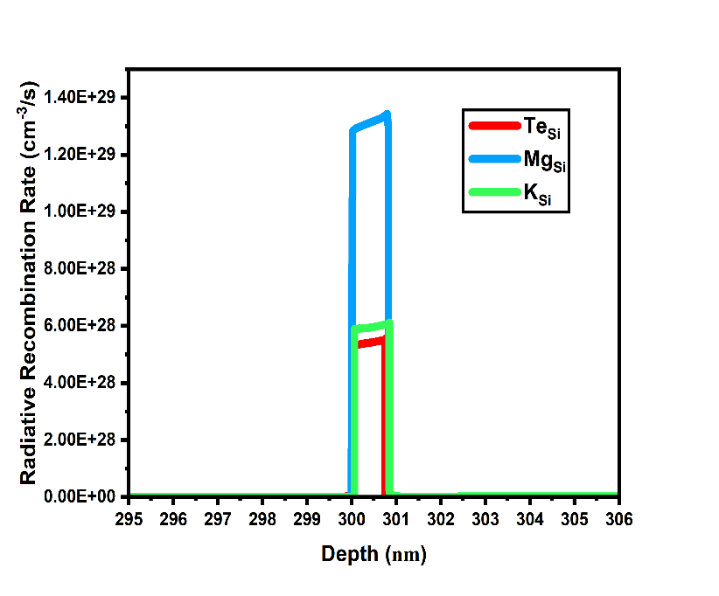
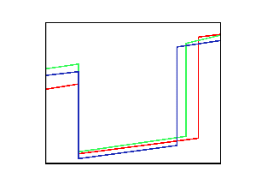
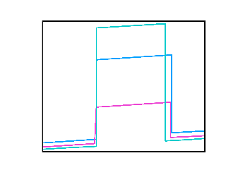
Results: Energy Band & Recombination Rate)
(a)
(b)
Figure: (a) Energy Band Diagram of the proposed LED under thermal equilibrium conditions, (b) Investigation of the radiative recombination rate in the proposed LED.

Slide 7
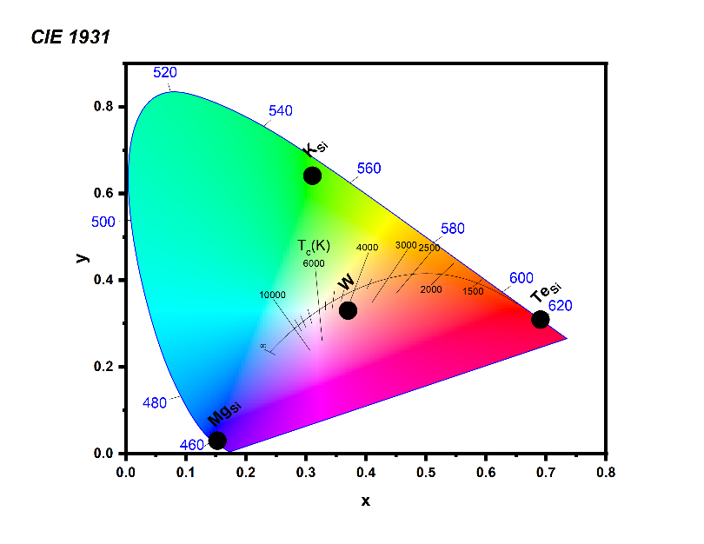
Results: CIE Mapping
Combined RGB points produce white light in chromaticity map
Notes:
The RGB emissions combine to produce white light in the CIE chromaticity diagram. We propose a compact white LED using three quantum wells, each tuned via width control for color modulation.

Slide 8


Questions and Comments
Please email any questions or comments to mahfuz@gmail.com or sajid@eee.buet.ac.bd
← Add email of presenting author
Dr. Sajid Muhaimin Choudhury
Principle Investigator, Quantum-, Photonic-, Antenna-, Computing-, Embedded- , and Renewable-energy Systems (Q-PACERS) Research Group
Associate Professor, Department of EEE, BUET
sajid.buet.ac.bd
Notes:
Thank you for your attention. I’d be happy to take any questions, or feel free to reach out to us via email.

